Slide 1
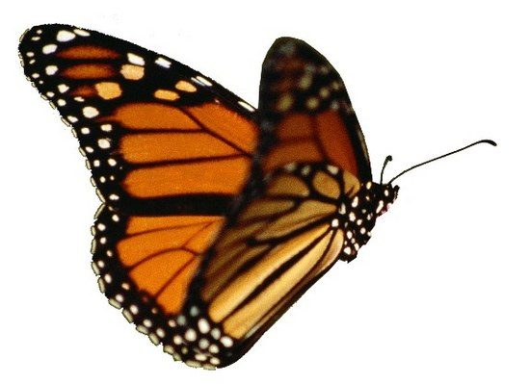
Growing Gardeners
Bonding Our Next Generation to Their Land

Slide 2
What Can Gardeners Share?

Slide 3
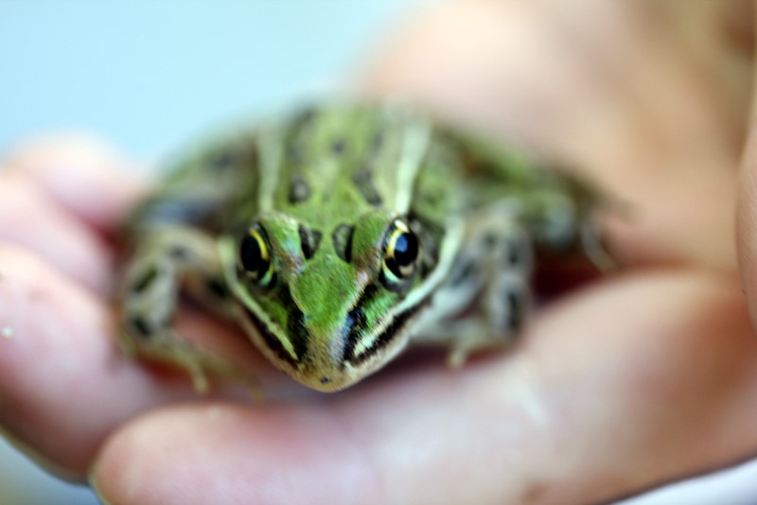
Stewardship
…the careful, responsible management of something entrusted to one's care.

Slide 4
Aldo Leopold
We abuse land because we regard it as a commodity belonging to us.
When we see land as a community to which we belong, we may begin to use it with love and respect.

Slide 5
Goals for Future Land Stewards, K-6
What they should know...
And be able to do

Slide 6
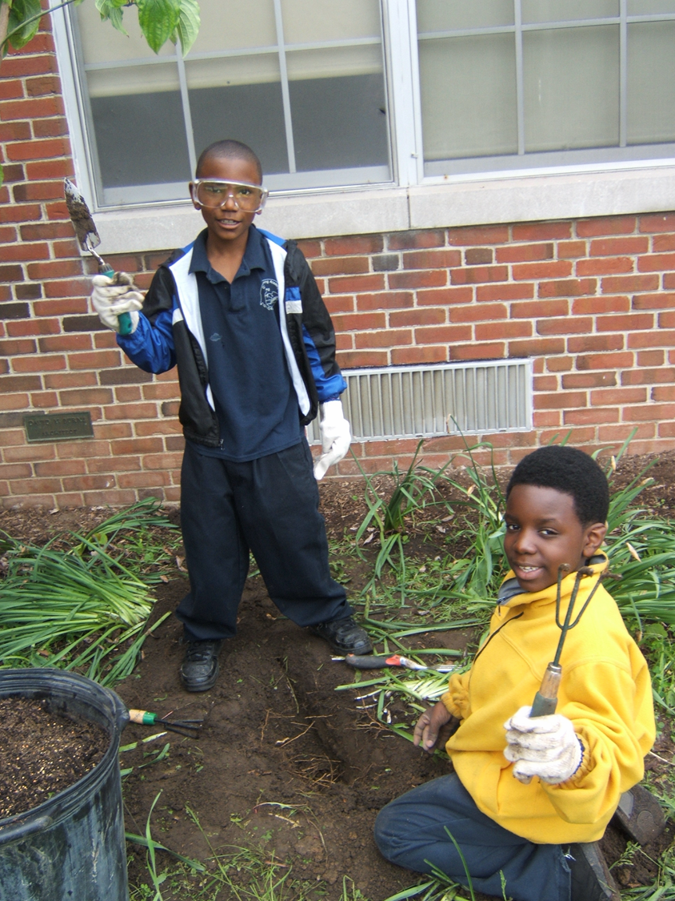
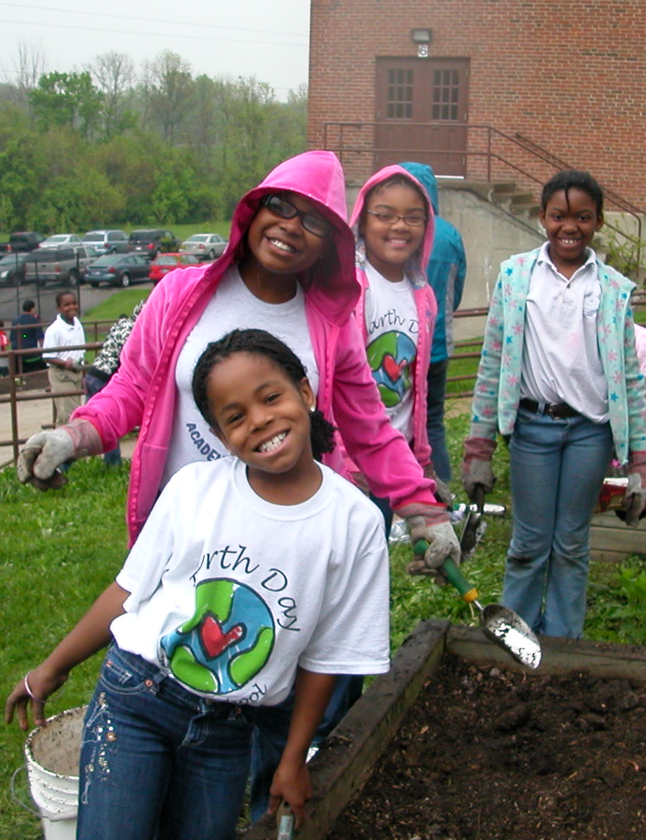
Skills they can use for a lifetime…

Slide 7
Trees and Shrubs
Know how trees/shrubs grow
Be able to plant them correctly

Slide 8
Soil
Know how soil helps plants grow
Prepare soil properly for a garden

Slide 9
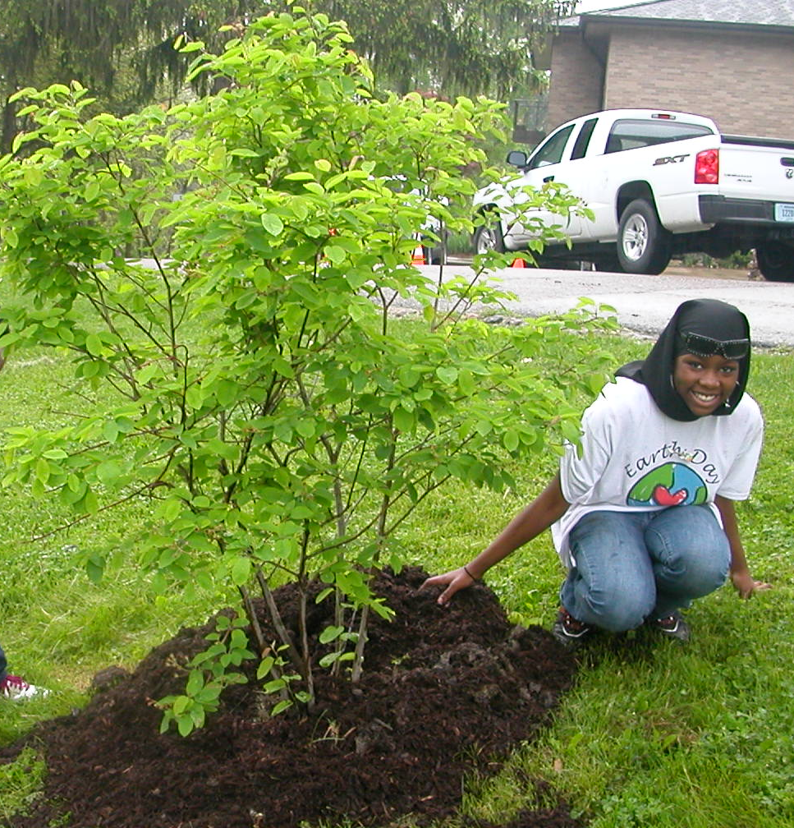
Mulch
Why we use it, what types
Apply mulch effectively

Slide 10
Invasive Plants
What they are, the damage they do
ID the most common, remove them correctly

Slide 11
Cycle of Life
Interdependence of insects and native plants
Explain why insects need native plants, give examples

Slide 12
Plant “Communities”
Woods edge, wetland, grassland; typical plants
Name common native plants found in each type

Slide 13
Field Guides
How to use a field guide
ID specific plants in the field

Slide 14
Plant Life Cycles
Know the different life cycles of flowering plants
Give examples of annuals, biennials, perennials

Slide 15
Annual Food Plants
Know about cool season, warm season, late season crops
Plan a garden for each season, with proper sowing and harvest dates

Slide 16
Caregiving
How to nurture plants from seed to harvest
Raise a crop of annual flowers or veggies

Slide 17
Weeds
What they are, their pros and cons
ID the most common, show how to remove them

Slide 18
Preparing Food
Major food crops, how to prepare them
Harvest food crops and prepare them to eat

Slide 19
Making More Plants
Basic ways to propagate plants
Demonstrate taking cuttings, collecting seed, dividing

Slide 20
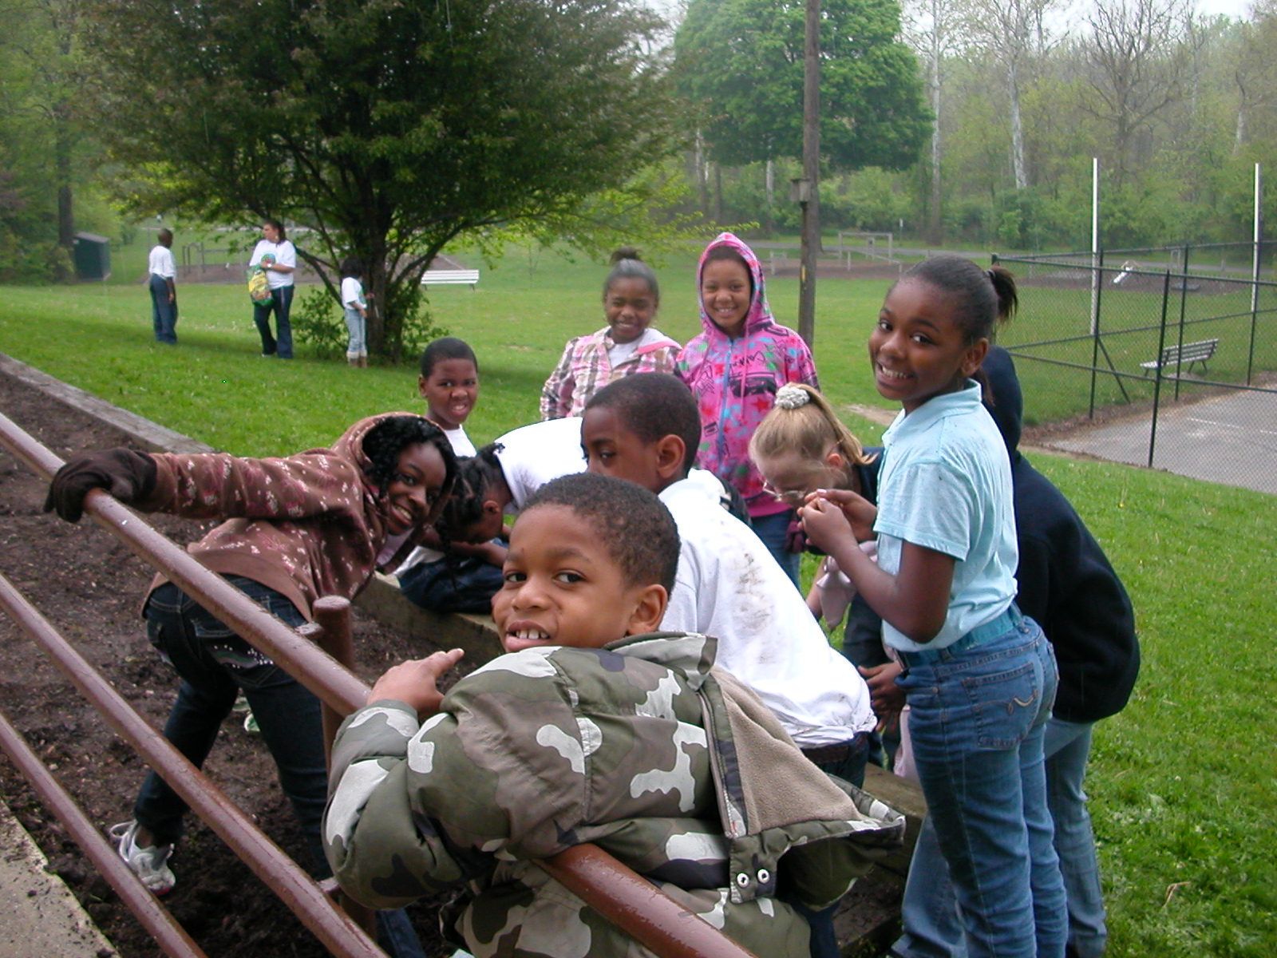
Tomorrow’s Stewards of the Land…Preparing for a Lifetime of Learning

