Slide 1
The Gathering Garden
Native Plants Fit for a Mansion

Slide 2
What’s a Native Plant?
Grew here before pioneer settlement
Difference between natives and exotics

Slide 3
Life Depends on Native Plants!
Plants capture the sun’s energy
Basis of the food chain
Insects need native plants
Lack of native plants threatens species survival
Notes:
Plants’ unique ability to capture the sun’s energy
Plants at the basis of the food chain
Why insects need native plants
How lack of native plants threatens our survival

Slide 4
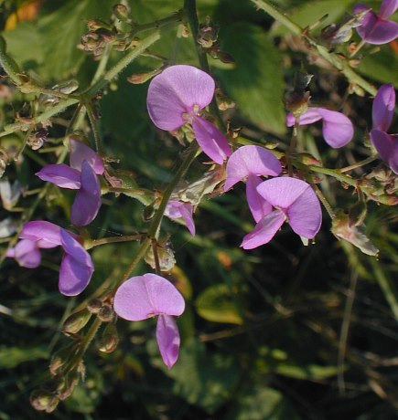
Get to Know Me!
Repertoire of familiar native plants
Stories about and characteristics of specific native plants
“Adopt” a native plant—tell classmates about it
Make a booklet of all the plants in the garden, each one doing a page on “their” plant
Notes:
Develop repertoire of familiar native plants
Learn stories about and characteristics of specific native plants
“Adopt” a native plant; tell classmates about it
Make a booklet of all the plants in the garden, each one doing a page on “their” plant

Slide 5
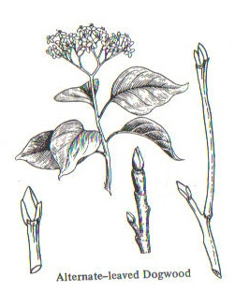
Botany Basics
Identify plant and flower parts
Compare like parts on different plants
Learn plant families
Notes:
Learn to identify plant and flower parts
Take advantage of multiple examples of structures to compare like parts
Use Jan Lacy’s Botany Illustrated coloring book
Learn plant families

Slide 6
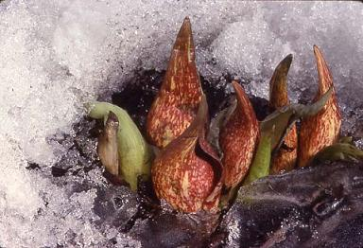
Rhythms of Nature
How nature unfolds in spring as the days grow warmer
Bloom times related to daily temperatures
Phenological indicators
Integrated pest management
Notes:
How nature unfolds in spring as the days grow warmer, natural rhythms
Recording bloom time, relating to daily temperatures
How farmers/integrated pest management use phenological indicators

Slide 7
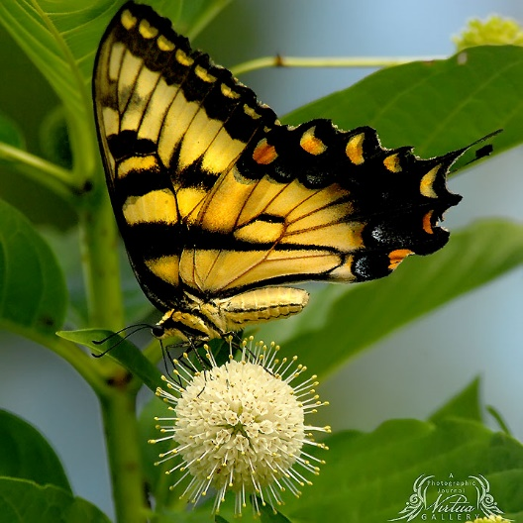
Native Plant Identification
Use field guides to find specific plants
Compare “cultivated varieties” with native species
Notes:
Given plant names, use field guides to find specific plants in the garden
Learn about “cultivated varieties” of native plants, compare with species

Slide 8
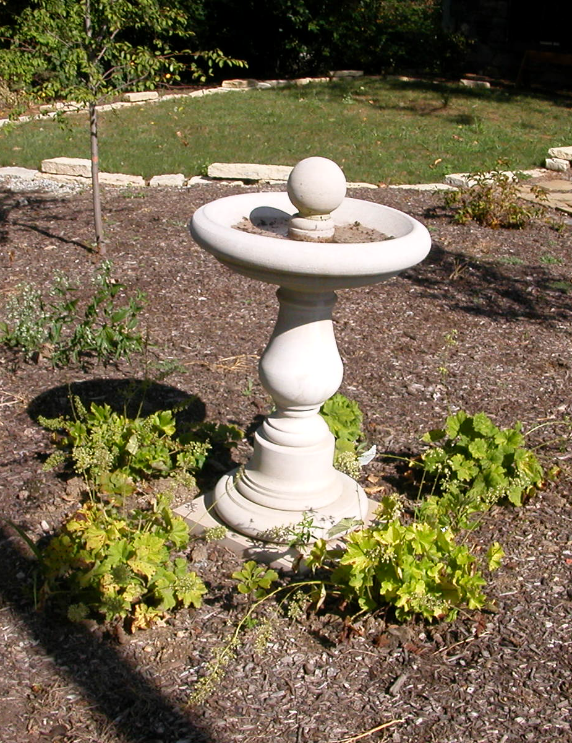
What Makes a Garden
Garden vs. natural area
Basics of garden design
Garden styles and traditions
Jens Jensen, Landscape Architect
Notes:
Difference between garden and natural area
Basics of garden design—each plant has a function, right plant/right place
Garden styles and traditions
Jens Jensen, Landscape Architect

Slide 9
Relate to Standards
6.3.4 Recognize that plants use energy from the sun to make sugar (i.e., glucose) by the process of photosynthesis.
6.3.5 Describe how all animals, including humans, meet their energy needs by consuming other organisms, breaking down their structures, and using the materials to grow and function.

Slide 10
Your Ready Resource
inpaws.org

