Slide 1
Know Your Weeds!
“Plants Out of Place” Frequently Seen at Cold Spring School

Slide 2
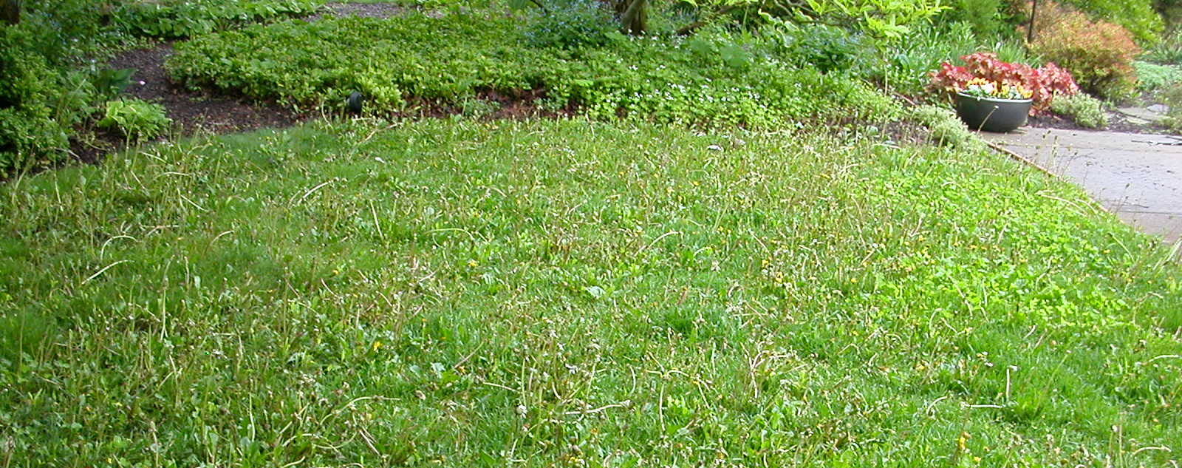
What’s a Weed?
A plant in the wrong place.
Usually refers to wild plants unwanted in human-controlled settings such as lawns, gardens, farm fields, and parks.

Slide 3
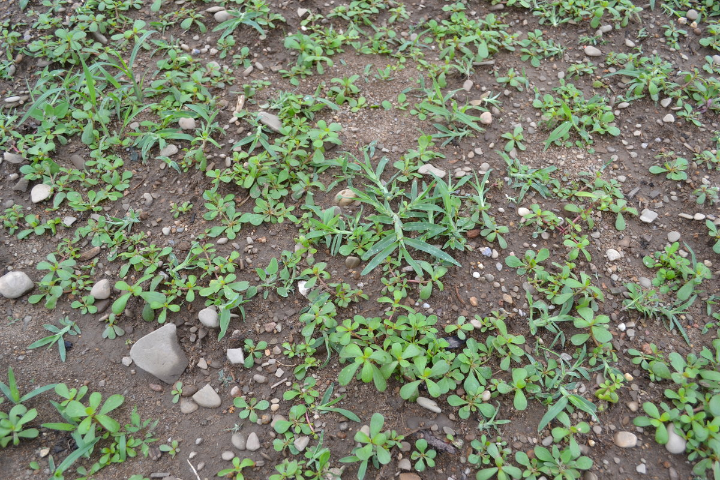
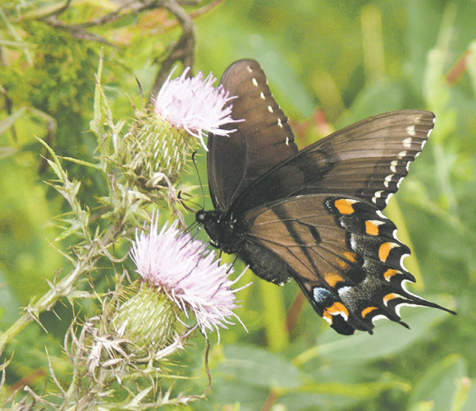
What’s Good About Weeds?
They cover up bare earth, protecting soil from erosion.
Some have medicinal qualities.
Some are edible.
Many support pollinators and beneficial insects.

Slide 4
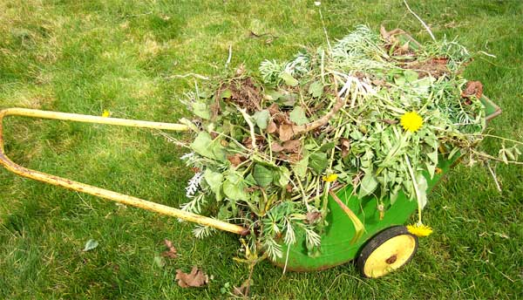
What’s Bad About Weeds?
Can crowd or overrun cultivated plants.
Can compete for nutrients.
Can spoil the look of a garden.
Can produce millions of seeds that stay in the soil for years.
Can spread fast by underground runners.
Can be hard to get rid of once out of control.

Slide 5
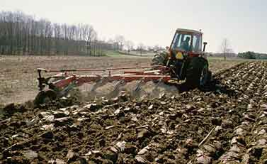
What’s Special About Weeds?
They thrive in “disturbed” environments where soil or natural vegetative cover has been damaged or frequently gets damaged.
Soil disturbances give the weeds advantages over desirable crops, pastures, or ornamental plants.

Slide 6
Can We Avoid Weeds?
We can avoid weeds by trying not to disturb the soil.
If we must disturb the soil, we should not leave it bare.

Slide 7
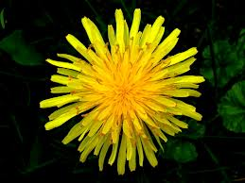
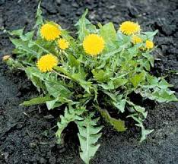
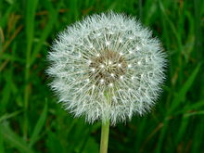
Dandelion
Perennial world-wide weed with deep taproot
Rapidly colonizes disturbed soil
Dig deep to get all of the taproot
Taraxacum officinale

Slide 8
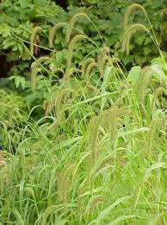
Giant foxtail
Summer annual
Tiny seeds in bristly panicles
Tall grassy foliage
Shallow fibrous roots
Native to Asia
Setaria faberi

Slide 9
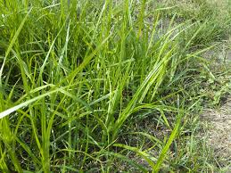
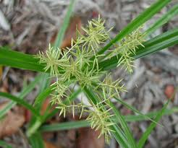
Yellow nutsedge
Perennial sedge
Bright green grassy leaves
Bristly yellow flowers
White roots carry tiny tubers
Native all over the world
Cyperus esculentus

Slide 10
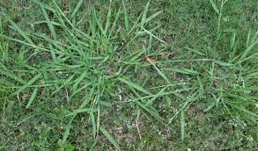
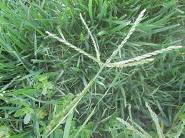
Crabgrass
Summer annual
Flat habit of growth
Finger-like seed head
Digitaria

Slide 11
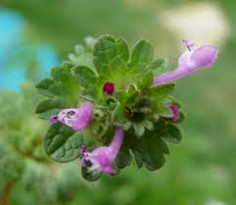
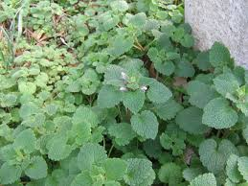
Henbit
Annual herb in the mint family
Low-growing, sprawling plant with hairy stems
A sea of purple flowers in early spring
Lamium amplexicaule

Slide 12
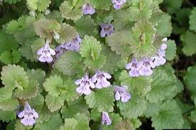
Creeping Charlie
Vining groundcover that loves to invade lawns
Tiny blue flowers in spring
Any roots or pieces of stem left in the ground can grow another plant
Glechoma hederacea

Slide 13
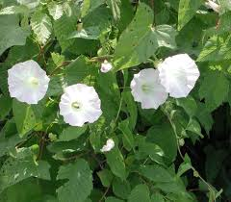
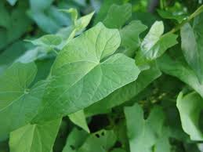
Field bindweed
Twining vine in the morning glory family
White, trumpet-shaped flowers
One of the most troublesome weeds in agricultural fields
Has extensive underground horizontal stems (rhizomes)
Convolvulus arvensis

Slide 14
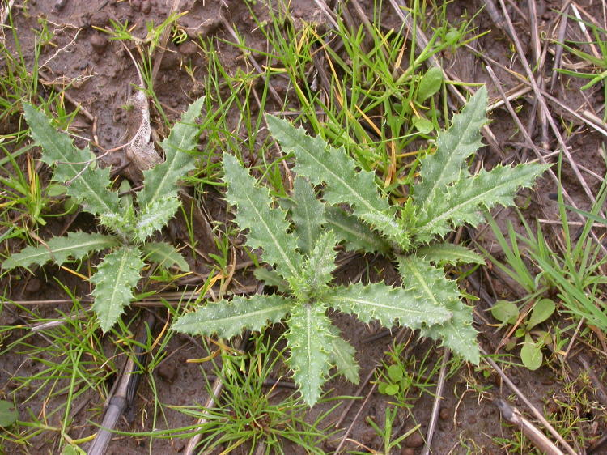
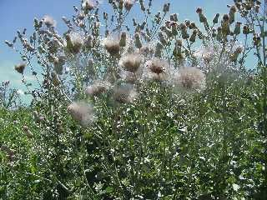
Canada thistle
Aggressive, creeping perennial weed
Horizontal roots may extend 15 feet or more and vertical roots may grow 6 to 15 feet deep.
Cirsium arvense

Slide 15
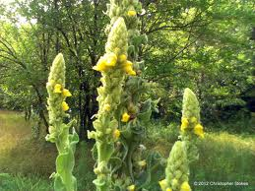
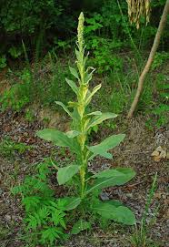
Woolly mullein
Biennial plant (two-year life cycle)
Large, soft fuzzy leaves
Tiny yellow flowers on tall stalks
Useful to beneficial insects
Native to Europe
One plant can make 100,000 seeds
Verbascum thapsus

Slide 16
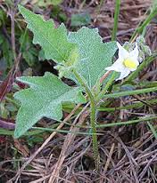
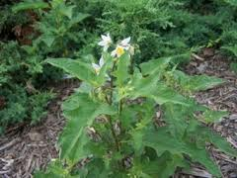
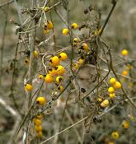
Horse Nettle
Thorny stems
Jagged leaves
White or bluish flowers
Deep tap root
Golden berries in fall
Solanum carolinense

Slide 17
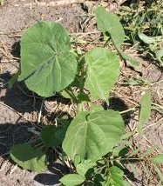
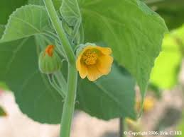
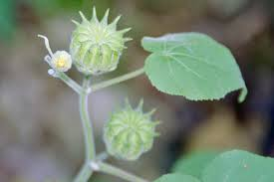
Velvetleaf
Summer annual
Heart-shaped leaves
Velvety leaves and stems
Yellow flowers
Seed pods resemble cheeses
Native to southern Asia
Abutilon theophrasti

Slide 18
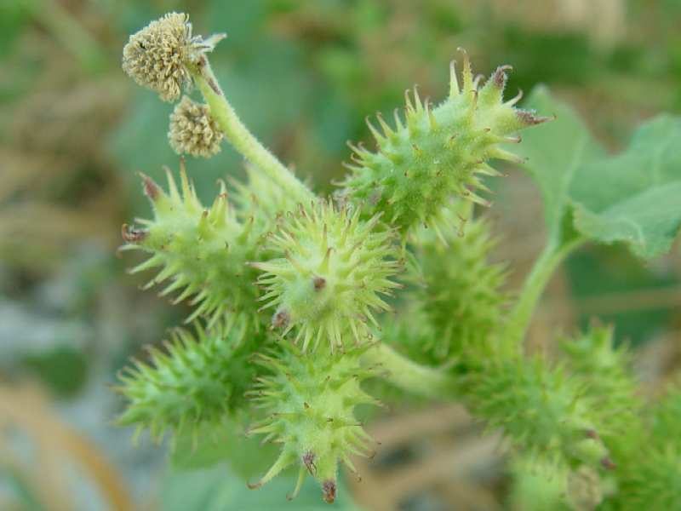
Common Cocklebur
Giant leaves
Seed capsules stick to you bigtime
Xanthium strumarium

